Slide 1

Experimental Operationalization and Inferential Conclusions in fMRI Investigation
Samuel J Castillo

Slide 2
Introduction
Neuroscience: Understanding the Brain
Functional Localization
Association of cognitive processes and functions with a specific area of network of areas within the brain
Case Studies
Animal Studies
Basic Science Methods
Neuroimaging

Slide 3
MRI: An Overview
Magnetic Resonance Imaging
Magnetic field induces resonance within protons
Radio-frequency coils receive transmissions from resonating protons
Creates image that reveals tissue location and type
Functional MRI (fMRI)
Traces deoxyhemoglobin proteins
Blood-oxygen Level Dependent Signal (BOLD)
Temporally indirect measure of neural activity
Hemodynamic Response Function

Slide 4
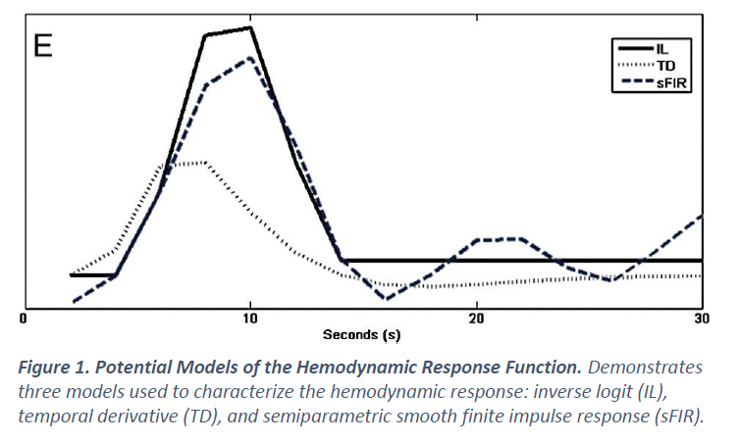
Hemodynamic Response Function

Slide 5
Functional Localization via fMRI: Validity at Stake
Advancement of functional localization techniques and tools
Failure to keep up with developments in the field
Boundaries of interpretive inference have become convoluted due to a collective misunderstanding of fMRI as an operationalization.
Operationalization: One’s means of capturing something qualitative or continuous in a quantitative and/or discrete manner
What are the boundaries of inferential conclusions within functional localization fMRI studies based on the limits of operationalization?

Slide 6
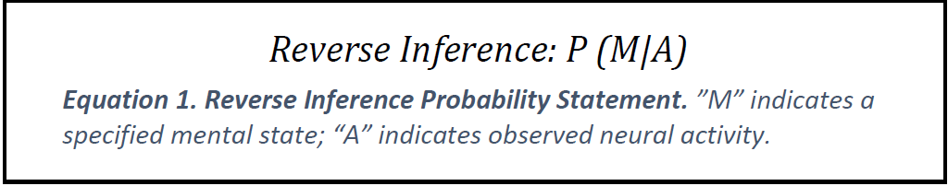
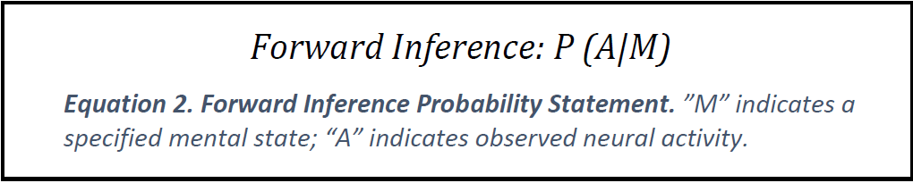
Inference: The Fundamental Basis of Data Interpretation

Slide 7
Operationalization: The Fundamental Basis of Inference
THEORY
Experimental Paradigm
Operationalization of Theory
Statistical Analysis
Operationalization of Experimental Paradigm
INFERENCE

Slide 8
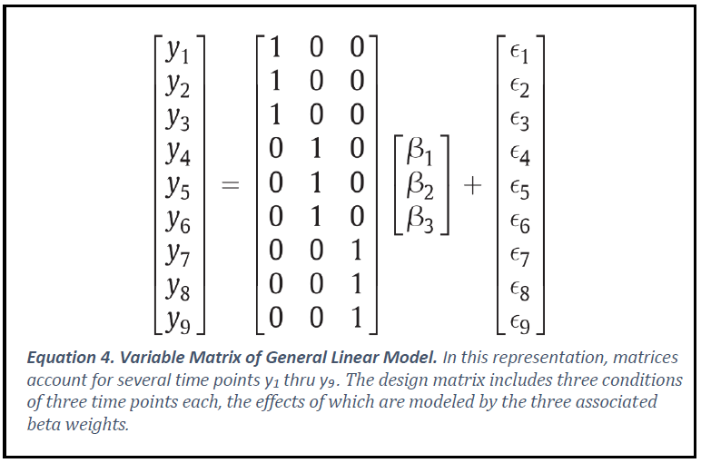
Overview of fMRI Statistical Analysis
General Linear Model

Slide 9
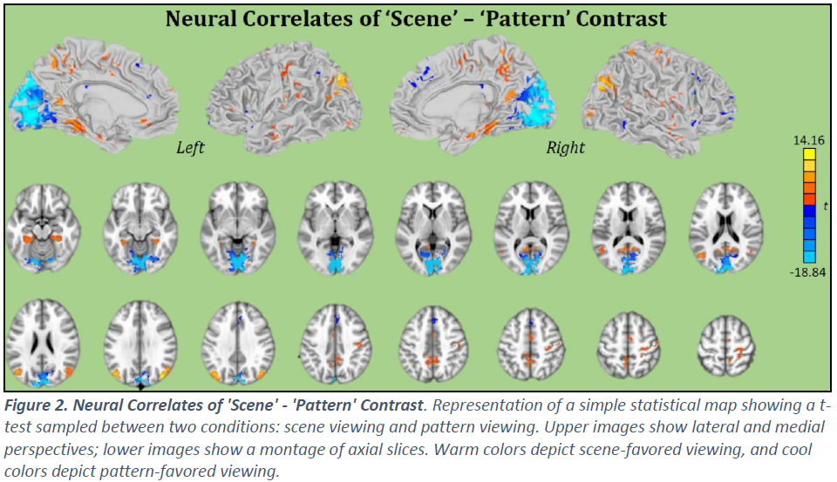
Goal of Statistical Analysis
Generate relevant contrasts that reveal quantitative significance of experimental paradigm

Slide 10

Statistical Analysis: Problems
Type I & II Errors
Unmeasured Factors

Slide 11
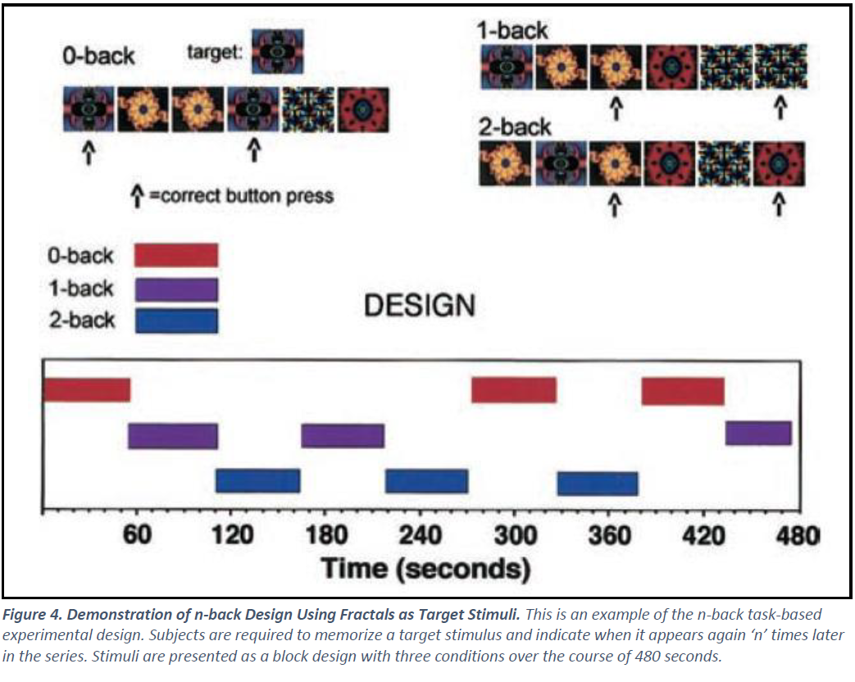
Overview of Experimental Paradigm Design
Focus: Task-Based Functional Localization

Slide 12
Paradigm Design: Problems
Failure to capture the breadth of verbal hypotheses
Complexity of question ↑
Ability to evoke relevant neural response ↓
Justification of Paradigms via Replication
Jacqueline Sullivan - Morris Water Maze

Slide 13
Whether we acknowledge it or not, the range of potential fMRI-based verbal hypotheses is dramatically limited by our ability to operationalize underlying psychological constructs.

Slide 14
Moving Forward
Bridging the Gap Between Operationalization and Inference
Analyze neuropsychological processes in context
Design paradigms with variability in mind
Hamilton and Huth
Natural stimuli in fMRI studies of language processing
Counterintuitive and contrary to highly controlled, simplified stimuli

Slide 15
Natural Stimuli
Would the person reasonably be exposed to this stimulus outside of the experimental setting?
Does the stimulus appear in the same context as it would in real life?
Is the subject’s motivation for perceiving and understanding the stimulus one that would occur outside of the experimental stimulation, i.e., in real life?
Complete, complex narratives > Isolated statements or words

Slide 16
Costs and Benefits of Natural Stimuli
Costs
Benefits
Statistical analysis is much more complex
Linearized Encoding Models
Natural stimuli apart from language are limited
Operationalization is nearer to theoretical perspective
Functional networks encompass a greater context
More relevant, generalizable results

Slide 17
Conclusion
The breadth of interpretative inference is principally limited by the operationalization upon which inferential conclusions rest.
Experimental operationalization ↔ Theoretical perspective
Natural stimuli help us bridge the gap now…
There is hope!

Slide 18
References
List is extensive – Please see printed thesis.

